Slide 1

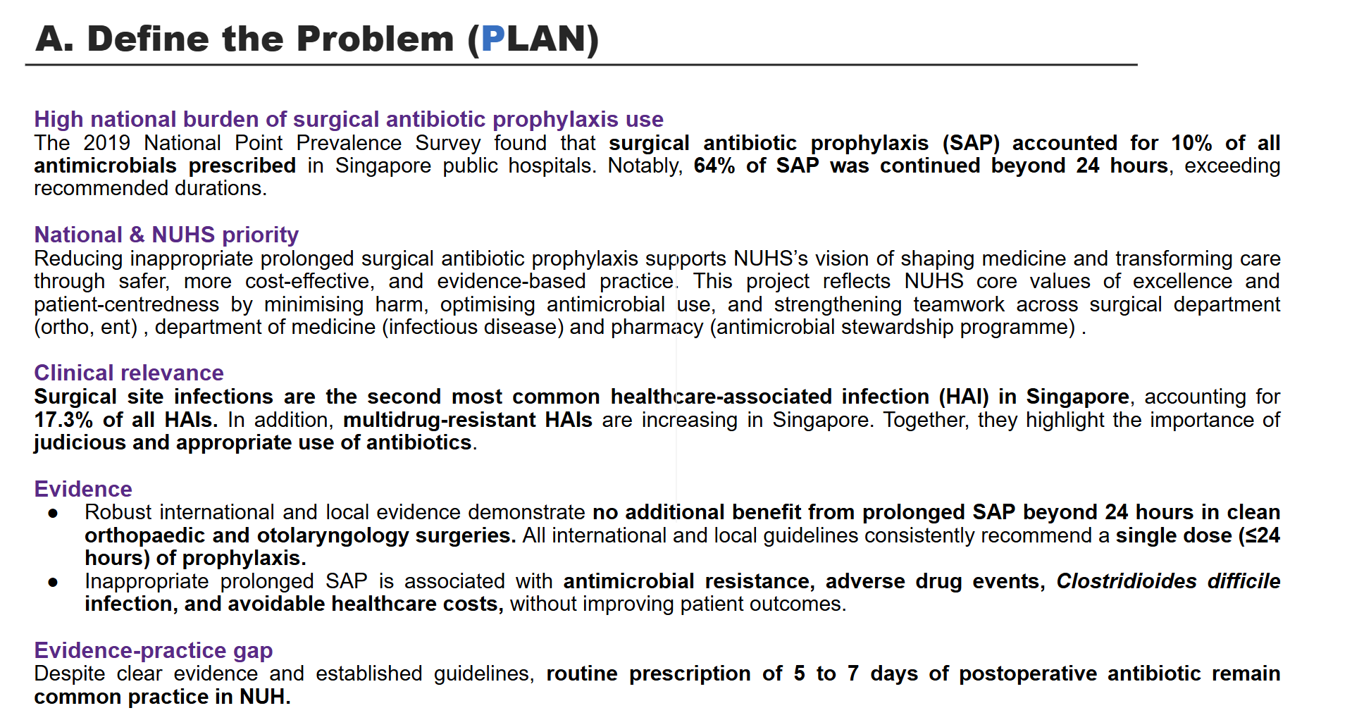
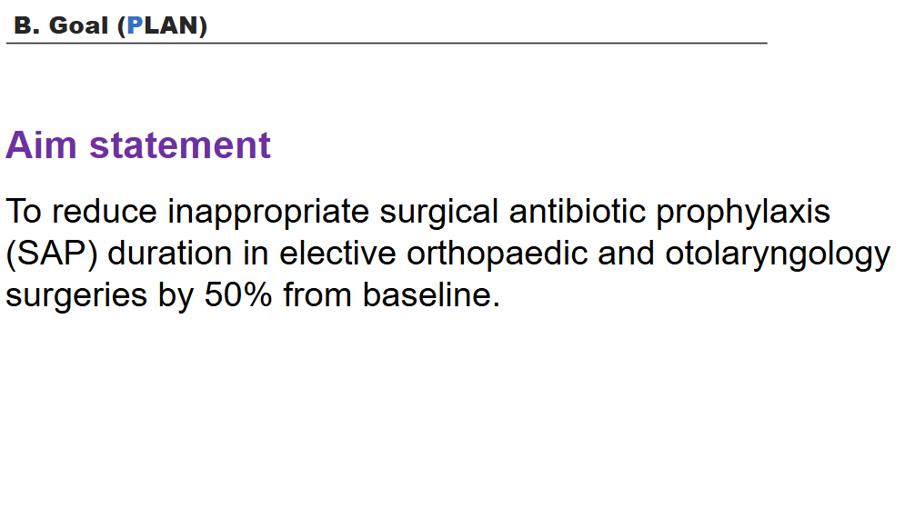
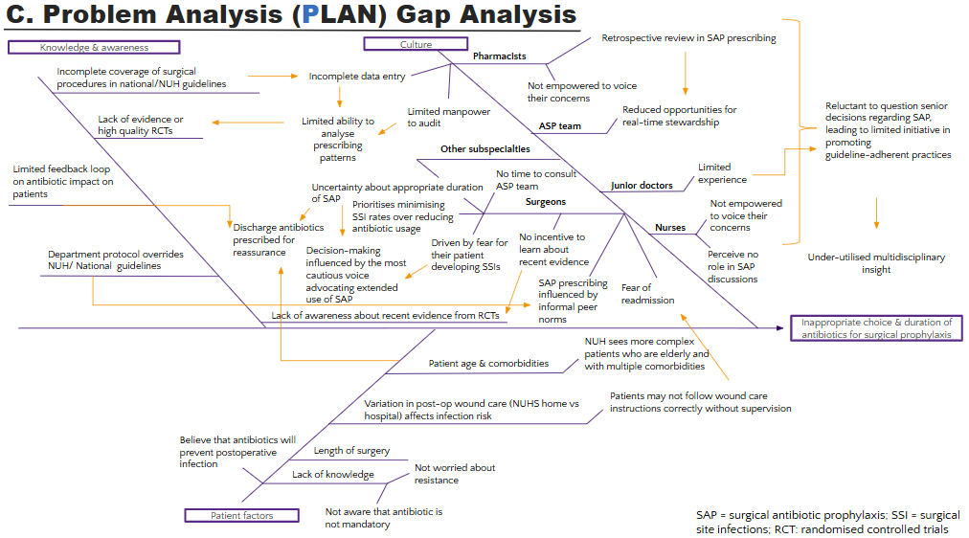
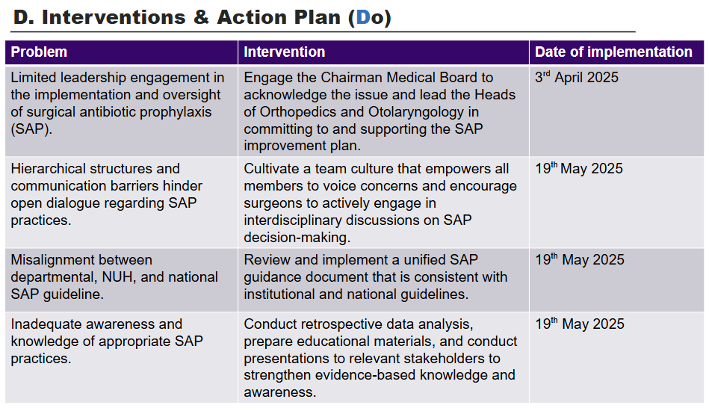
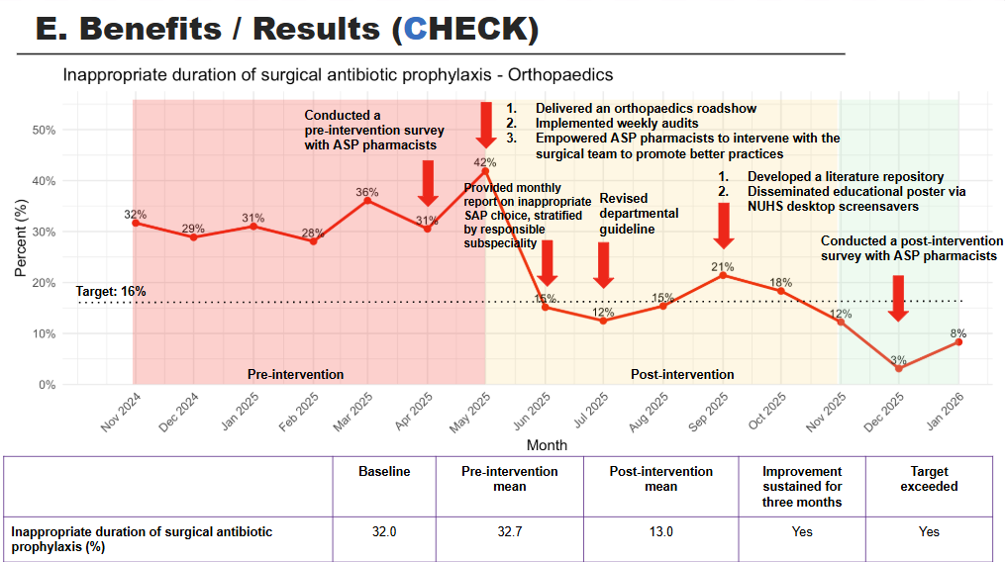
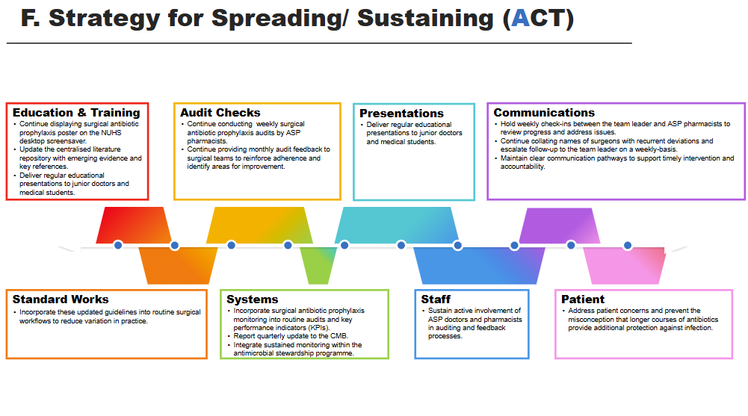
Incredible Care QIX Award (Process Excellence)
Project Title: Reducing inappropriate surgical antibiotic prophylaxis use in elective surgeries
Department: Medicine | Period: April 2025 to January 2026 | Facilitators: A/Prof Dennis Hey, Dr Jeremy Chee
Sponsors (HODs): Adj A/Prof Jolene Oon Ee Ling | Team Leader/s: Dr Mo Yin
Team Members: Chen Hui Hiong, Wu Jia En, Dr Quah Joan, Dr Nares Smitasin (Acknowledgements: Atharvi Gupta, Geraldine Foo, Rofina, Darren Teo, Goh Wen Jun, Wendy Ng, Heng Lin, Wei Liang, Qing Xiao, Hui Wen, Lim Kian Huat)

Slide 2
A. Define the Problem (PLAN)
High national burden of surgical antibiotic prophylaxis use
The 2019 National Point Prevalence Survey found that surgical antibiotic prophylaxis (SAP) accounted for 10% of all antimicrobials prescribed in Singapore public hospitals. Notably, 60% of SAP was continued beyond 24 hours, exceeding recommended durations.¹
National & NUHS priority
Reducing inappropriate prolonged surgical antibiotic prophylaxis supports NUHS’s vision of shaping medicine and transforming care through safer, more cost-effective, and evidence-based practice. This project reflects NUHS core values of excellence and patient-centredness by minimising harm, optimising antimicrobial use, and strengthening teamwork across surgical department (orthopaedic, otolaryngology) , department of medicine (infectious disease) and pharmacy (antimicrobial stewardship programme) .
Clinical relevance
Surgical site infections are the second most common healthcare-associated infection (HAI) in Singapore, accounting for 17.3% of all HAIs.^{1,2} In addition, multidrug-resistant HAIs are increasing in Singapore. Together, they highlight the importance of judicious and appropriate use of antibiotics.
Evidence
Robust international and local evidence demonstrate no additional benefit from prolonged SAP beyond 24 hours in clean orthopaedic and otolaryngology surgeries. All international and local guidelines consistently recommend a single dose (≤24 hours) of prophylaxis.¹
Inappropriate prolonged SAP is associated with antimicrobial resistance, adverse drug events, Clostridium difficile infection, and avoidable healthcare costs, without improving patient outcomes.³
Evidence-practice gap
Despite clear evidence and established guidelines, routine prescription of 5 to 7 days of postoperative antibiotic remain common practice in NUH.
Notes:
National point prevalence survey
Point prevalence surveys on antimicrobial utilisation conducted by Singapore public hospitals in 2019 showed that the prophylactic use of antimicrobials for surgeries accounted for 10% of all antimicrobial agents prescribed. Of concern, 64% of these prophylactic antimicrobials were administered for more than 24 hours.
In Singapore, SSI were the second most common healthcare associated infection after pneumonia, accounting for 17.3% of HAI.
Why we chose Ortho, subsequently added ENT (include charts)
Duration facts
Choice facts
MOH priority 2025
NUH goals (NAP)
What is the consumption of antibiotics in NUH/ Singapore (https://pmc.ncbi.nlm.nih.gov/articles/PMC10464409/)
National Strategic Action Plan (NSAP) on AMR

Slide 3
Aim statement
B. Goal (PLAN)
To reduce inappropriate surgical antibiotic prophylaxis (SAP) duration in elective orthopaedic and otolaryngology surgeries by 50% from baseline.

Slide 4
C. Problem Analysis (PLAN) Gap Analysis
Culture | Knowledge and awareness | Patient factors​
Experience-driven prescribing overrides standard protocols / clinicians’ previous experiences of patients developing surgical site infections while prescribing surgical antibiotic prophylaxis according to the guidelines​. | Some surgical procedures are not included in the surgical prophylaxis guideline​. | Older patients.
Defensive prescribing / clinicians believe that prescribing antibiotics is necessary to protect themselves when retrospectively defending their decision / conferring a sense of having done everything possible for the patient to prevent surgical site infections. | Lack of high-quality randomised controlled trials to guide which surgical procedures require antibiotics and the optimal duration of administration. | Patients with compromised immune system and multiple comorbidities.
Discharge with antibiotics for reassurance of the consultant / extra layer of safety needed by surgeons because surgical site infections are viewed as personal responsibility for an infectious complication. | Lack of awareness about updated evidence from randomised controlled trials. | Wound care and drainage​.
Prescribing habits shaped by what is commonly done in the team, not by scientific evidence. | No feedback channel from patients and antibiotic stewardship team on antibiotic side effects and efficacy. | Longer duration of surgery.
Decision-making around surgical antibiotic prophylaxis often occurs in silos​ (e.g. the antibiotic stewardship team is not involved during the decision-making​ stage.) | Outdated and conflicting departmental, hospital, and national guidelines​ | ​Surgical complexity requiring multidisciplinary input, leading to divergent perspectives.
Believes that antibiotics are inherently effective and harmless, and that prescribing longer durations longer duration is safe and preferable for preventing surgical site infections. | Preference for department guideline rather than hospital-wide guidelines.​ | ​Lack of awareness about the harms of antibiotics.
Time constraints in surgical settings and post-op wards. | Disagreements between departments involved in the care of same patients. | ​Expectation of postoperative antibiotic use.
Unclear responsibility for starting, reviewing, and stopping antibiotics across team members. | ​Uncertainty about the length of prophylaxis recommended in the hospital guideline​. | ​Focus on immediate risks (e.g. surgical site infections) over longer-term consequences (e.g. antimicrobial resistance).

Slide 5
C. Problem Analysis (PLAN) Gap Analysis
Culture
Retrospective review in SAP prescribing
Knowledge & awareness
Pharmacists
Incomplete coverage of surgical procedures in national/NUH guidelines
Incomplete data entry
Not empowered to voice their concerns
Limited manpower to audit
Reduced opportunities for real-time stewardship
Reluctant to question senior decisions regarding SAP, leading to limited initiative in promoting guideline-adherent practices
Lack of evidence or high quality RCTs
Limited ability to analyse prescribing patterns
ASP team
Other subspecialties
Limited feedback loop on antibiotic impact on patients
No time to consult ASP team
Limited experience
Uncertainty about appropriate duration of SAP
Junior doctors
Prioritises minimising SSI rates over reducing antibiotic usage
Surgeons
Not empowered to voice their concerns
Discharge antibiotics prescribed for reassurance
No incentive to learn about recent evidence
Nurses
Decision-making influenced by the most cautious voice advocating extended use of SAP
Driven by fear for their patient developing SSIs
Department protocol overrides NUH/ National guidelines
Perceive no role in SAP discussions
Under-utilised multidisciplinary insight
SAP prescribing influenced by informal peer norms
Fear of readmission
Lack of awareness about recent evidence from RCTs
Inappropriate choice & duration of antibiotics for surgical prophylaxis
NUH sees more complex patients who are elderly and with multiple comorbidities
Patient age & comorbidities
Variation in post-op wound care (NUHS home vs hospital) affects infection risk
Patients may not follow wound care instructions correctly without supervision
Believe that antibiotics will prevent postoperative infection
Length of surgery
Lack of knowledge
Not worried about resistance
Patient factors
Not aware that antibiotic is not mandatory
SAP = surgical antibiotic prophylaxis; SSI = surgical site infections; RCT: randomised controlled trials

Slide 6
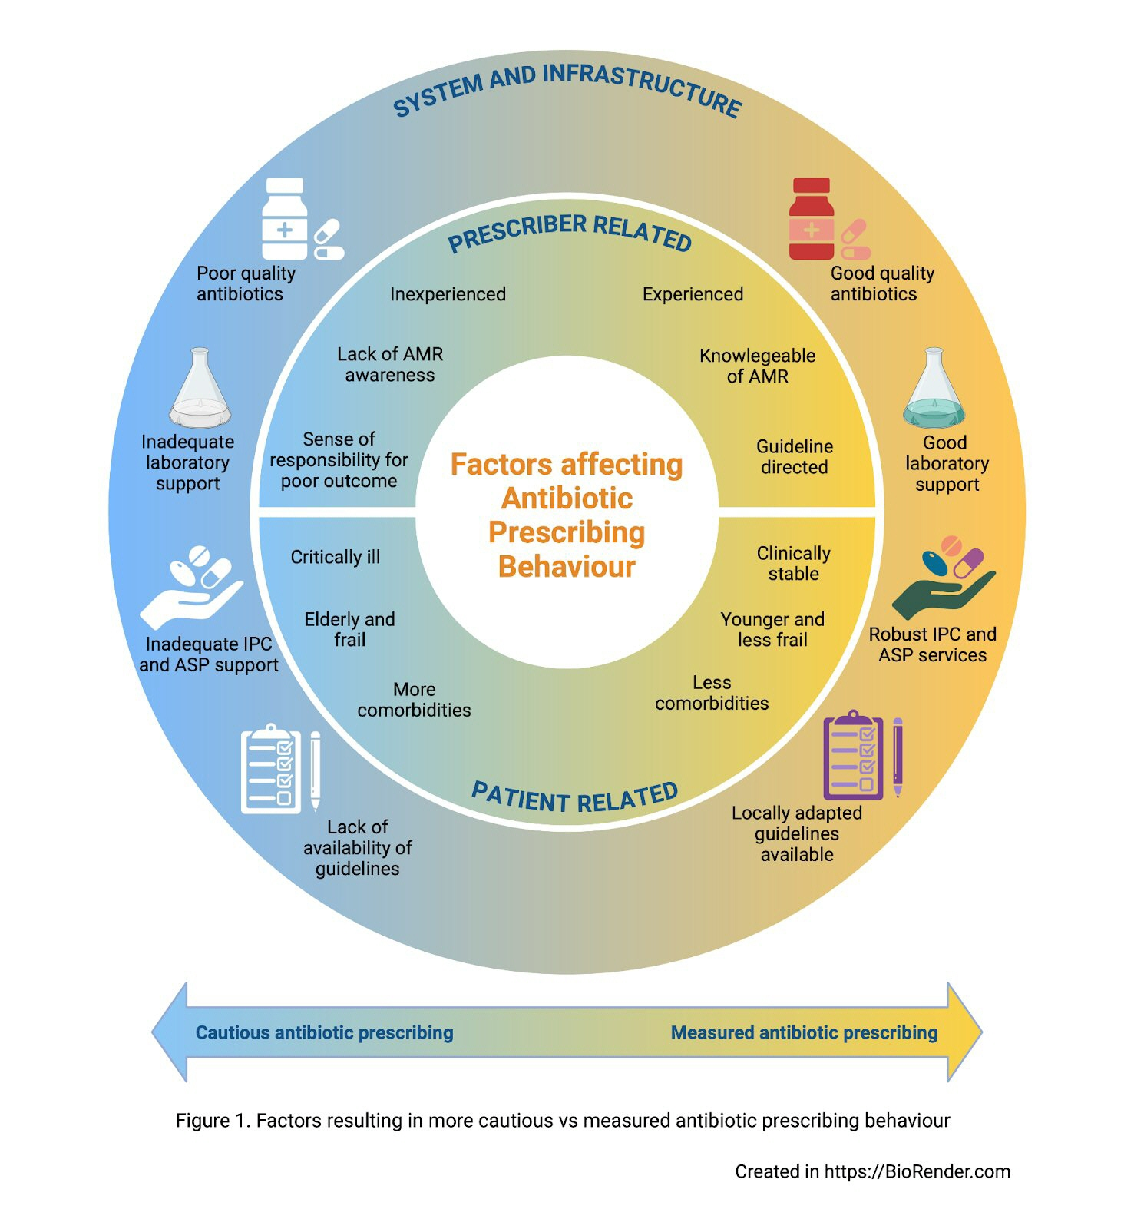
Factors influencing antibiotic prescribing behavior
C. Problem Analysis (PLAN) Gap Analysis
Methodological background:
Drawn from 194 semi-structured interviews and ethnographic observations
Participants included doctors, nurses, pharmacists, and management staff
For optimal antibiotic use, efforts must be made to:
Improve prescriber training and guideline access
Support clinical decision-making & robust lab and infrastructure
Provide systematic support like effective stewardship programs
Chhabra, et al. under review

Slide 7
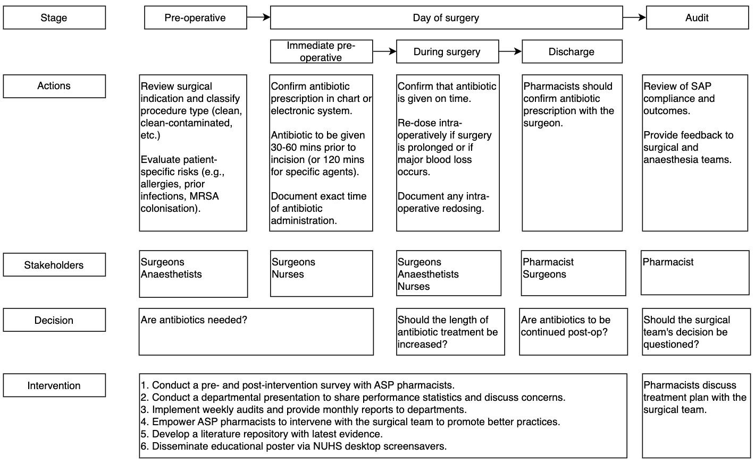
C. Problem Analysis (PLAN) Value Stream Map

Slide 8
D. Interventions & Action Plan (Do)
Problem | Intervention | Date of implementation
Limited leadership engagement in the implementation and oversight of surgical antibiotic prophylaxis (SAP). | Engage the Chairman Medical Board to acknowledge the issue and lead the Heads of Orthopedics and Otolaryngology in committing to and supporting the SAP improvement plan. | 3rd April 2025
Hierarchical structures and communication barriers hinder open dialogue regarding SAP practices. | Cultivate a team culture that empowers all members to voice concerns and encourage surgeons to actively engage in interdisciplinary discussions on SAP decision-making. | 19th May 2025
Misalignment between departmental, NUH, and national SAP guideline. | Review and implement a unified SAP guidance document that is consistent with institutional and national guidelines. | 19th May 2025
Inadequate awareness and knowledge of appropriate SAP practices. | Conduct retrospective data analysis, prepare educational materials, and conduct presentations to relevant stakeholders to strengthen evidence-based knowledge and awareness. | 19th May 2025

Slide 9
PDCA 1: Promoting leadership in SAP
Review and present current SAP practice data.
Engage key stakeholders (Chairman Medical Board, surgeons, ASP consultants, and pharmacists).
Provide monthly feedback to orthopaedics and otolaryngology departments.
Prompt departmental guideline review and updates.
Present point prevalence survey data and proposed intervention plan to the Chairman Medical Board.
Engage ASP team and pharmacists to analyze SAP practices.
Provide department-specific charts monthly.
The Chairman Medical Board will support the Heads of orthopaedics and otolaryngology departments to review their departmental guidelines.
Plan
Do
Revised guidelines and audit antibiotic prescribing practice based on revised guide.
Prospective evaluation and feedback to align with local consensus.
Act
Check
Document leadership support and departmental response.
Track progress against agreed timelines.
Evaluate changes in commitment.
Monitor whether revised guidelines are submitted and align with NUH and National guidelines.

Slide 10
PDCA 2: Strengthening communication & team culture to improve SAP compliance
Pharmacists to document all SAP interventions, including clinical team response (accepted/ rejected) and rationale.
Introduce informal, collegial reminders to surgeons to support timely SAP review and discussion.
Conduct anonymous pre- and post-intervention surveys and reinforce programme leadership support for ASP pharmacists.
Establish a standardised system for pharmacists to track SAP prescribing and document interventions for inappropriate SAP.
Analyse intervention records to identify acceptance patterns and reasons for rejection.
Conduct pre- and post-intervention surveys to identify perceived barriers to pharmacist-surgeon interventions.
.
Plan
Do
Quantitative:
Monthly count of pharmacist SAP interventions.
Proportions of accepted versus rejected interventions.
Qualitative:
Pharmacists’ reflections on confidence, engagement, and quality of SAP-related discussions with surgeons.
Conduct regular check-ins with ASP pharmacists to review barriers, enablers, surgeon responses, and unresolved matters.
Revise NUH SAP guideline to support risk stratification, audit, and targeted interventions.
Act
Check

Slide 11
PDCA 3: Develop unified SAP compliance guidance
Request each speciality to review and revise SAP guideline to:
Align with national and NUHS standards.
Document and justify deviations using supporting literature.
Highlight intra-specialty variations to promote ownership and peer benchmarking.
Identify surgical procedures not covered in existing SAP guidelines.
Present specialty-specific SAP data at departmental meetings and via monthly reports.
Share key evidence from the literature to support standardisation and informed deviations.
Plan
Do
Facilitate cross-specialty discussions to critically appraise current SAP practices.
Incorporate agreed additions and clarifications into unified NUH SAP guideline.
Assess specialty engagement and readiness to revise NUHS SAP guideline.
Receive updated speciality SAP guidelines, including documented justifications and proposed additions.
ASP team to review revised guidelines for alignment with NUHS priorities.
Act
Check

Slide 12
PDCA 4. Improving knowledge & awareness of SAP
Collaborate with orthopedics and otolaryngology departments and ASP pharmacists to access retrospective SAP data.
Conduct target trial emulation.
Identify patterns of antibiotic overuse and misalignment with guidelines.
Deliver sessions for surgeons, junior doctors, and pharmacists.
Create an informative poster and display it on the NUHS screensaver for 6 months.
Establish a literature repository with updated evidence.
Retrospective analysis of SAP datasets to evaluate SSI incidence, stratified by procedure type.
Target trial emulation analysis based on EPIC data to estimate the effect of guideline-concordant vs inappropriate SAP on SSI risk.
Plan
Do
Deliver an educational talk during World Antimicrobial Awareness Week 2025 to disseminate findings and reinforce evidence-based SAP practices.
Analyse the retrospective data to quantify:
Proportion of patients receiving inappropriate antibiotic choice and/or duration.
Association between SAP non-compliance and SSI risk
Review Q&A following the educational sessions to identify common misconceptions and behavioral barriers.
Act
Check

Slide 13
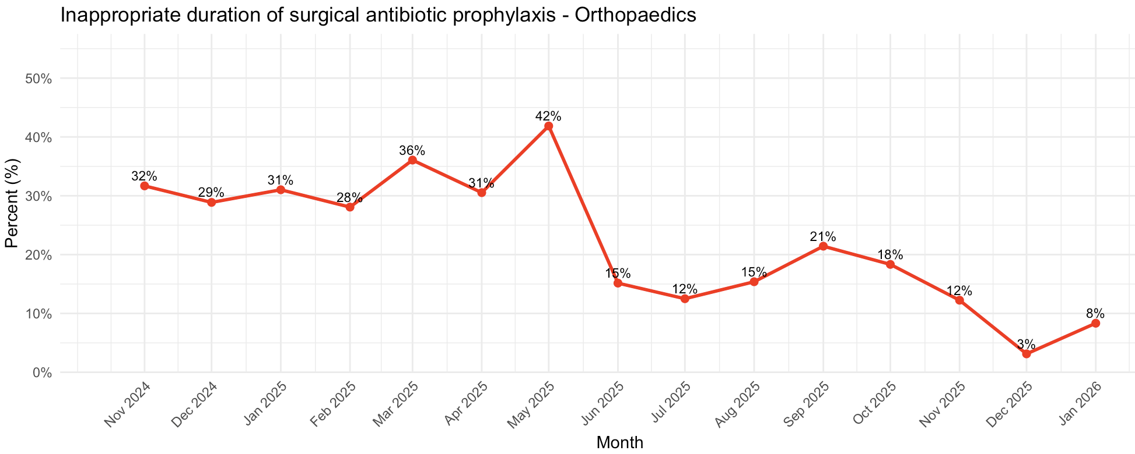
E. Benefits / Results (CHECK)
Conducted a pre-intervention survey with ASP pharmacists
Delivered an orthopaedics roadshow
Implemented weekly audits
Empowered ASP pharmacists to intervene with the surgical team to promote better practices
Developed a literature repository
Disseminated educational poster via NUHS desktop screensavers
Provided monthly report on inappropriate SAP choice, stratified by responsible subspeciality
Revised departmental guideline
Conducted a post-intervention survey with ASP pharmacists
Target: 16%
Pre-intervention
Post-intervention
 | Baseline | Pre-intervention mean | Post-intervention mean | Improvement sustained for three months | Target exceeded
Inappropriate duration of surgical antibiotic prophylaxis (%) | 32.0 | 32.7 | 13.0 | Yes | Yes
Notes:
monthly report june onwards

Slide 14
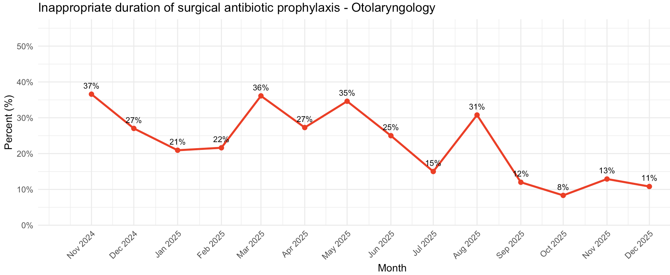
E. Benefits / Results (CHECK)
Delivered an otolaryngology roadshow
Implemented weekly audits
Empowered ASP pharmacists to intervene with the surgical team to promote better practices
Developed a literature repository
Disseminated educational poster via NUHS desktop screensavers
Provided monthly report on inappropriate SAP choice, stratified by responsible subspeciality
Conducted a pre-intervention survey with ASP pharmacists
Conducted a post-intervention survey with ASP pharmacists
Revised departmental guideline
Target: 18.5%
 | Baseline | Pre-intervention mean | Post-intervention mean | Improvement sustained for three months | Target exceeded
Inappropriate duration of surgical antibiotic prophylaxis (%) | 37.0 | 27.6 | 11.0 | Yes | Yes

Slide 15
Average duration of prophylactic antibiotics prescribed for orthopaedic and otolaryngology surgeries
E. Benefits / Results (CHECK)
Projected cost saving for reduced surgical antibiotic prophylaxis duration*
*Projected cost based on:
Augmentin $0.40/tab for 7 days (prolonged SAP course)
Improvement of prolonged SAP from 30% to 15%
Time spent on each SAP case: 30 minutes
Average total manpower cost of $250/hour for ASP consultants, surgeons, and pharmacists.
Drug cost saved
$320/ month
Manpower saved
$4750/month
 | Pre-QIP | Post-QIP
Average duration of surgical antibiotic prophylactic for elective orthopaedic surgeries (days) | 6.39 | 2.15
Average duration of surgical antibiotic prophylactic for elective otolaryngology surgeries (days) | 7.81 | 1.38
Total monthly savings
$5070
Total yearly savings
$60, 840

Slide 16
F. Strategy for Spreading/ Sustaining (ACT)
Education & Training
Continue displaying surgical antibiotic prophylaxis poster on the NUHS desktop screensaver.
Update the centralised literature repository with emerging evidence and key references.
Deliver regular educational presentations to junior doctors and medical students.
Audit Checks
Continue conducting weekly surgical antibiotic prophylaxis audits by ASP pharmacists.
Continue providing monthly audit feedback to surgical teams to reinforce adherence and identify areas for improvement.
Presentations
Deliver regular educational presentations to junior doctors and medical students.
Communications
Hold weekly check-ins between the team leader and ASP pharmacists to review progress and address issues.
Continue collating names of surgeons with recurrent deviations and escalate follow-up to the team leader on a weekly-basis.
Maintain clear communication pathways to support timely intervention and accountability.
2005
2007
2008
2009
2010
2013
Standard Works
Incorporate these updated guidelines into routine surgical workflows to reduce variation in practice.
Systems
Incorporate surgical antibiotic prophylaxis monitoring into routine audits and key performance indicators (KPIs).
Report quarterly update to the CMB.
Integrate sustained monitoring within the antimicrobial stewardship programme.
Staff
Sustain active involvement of ASP doctors and pharmacists in auditing and feedback processes.
Patient
Address patient concerns and prevent the misconception that longer courses of antibiotics provide additional protection against infection.

Slide 17
F. Strategy for Spreading/ Sustaining (ACT)
Sustaining
Weekly prospective audit and feedback for SAP prescription.
Roadshow to more surgical departments to share progress and gather feedback for continuous improvement.
EPIC medication panel for specific elective surgeries with predefined SAP duration.
Vertical spread
Surveillance of surgical site infections following elective surgeries.
Train junior doctors and medical students on institution SAP guide and documentation of indication.
Horizontal spread
Sharing this quality improvement initiative and engage more surgical departments to expand SAP optimisation.
Collaboration with National Antimicrobial Stewardship Expert Panel (NASEP) to disseminate initiatives to other hospitals.
Peer-reviewed publication to support adoption beyond NUH.

Slide 18
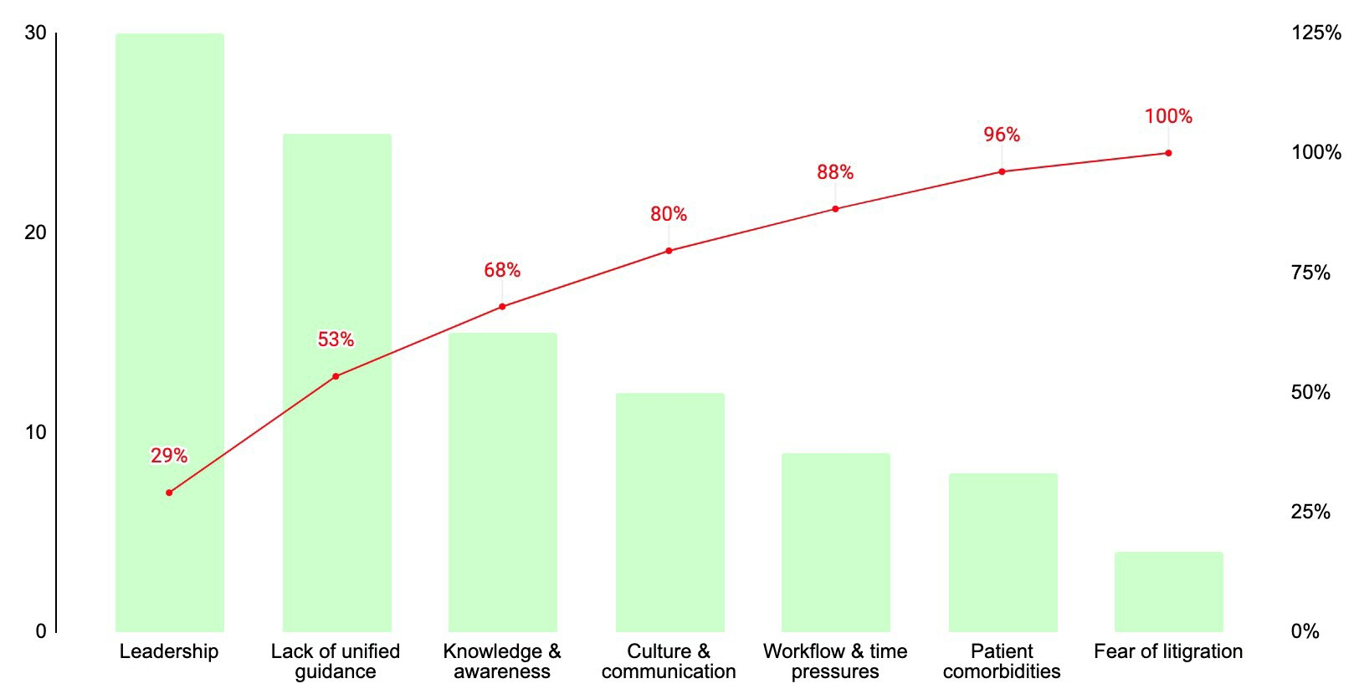
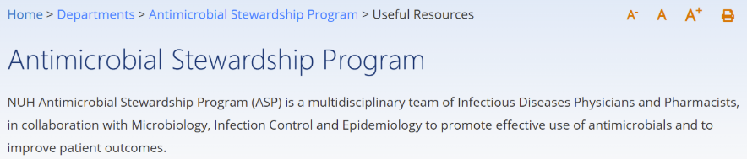
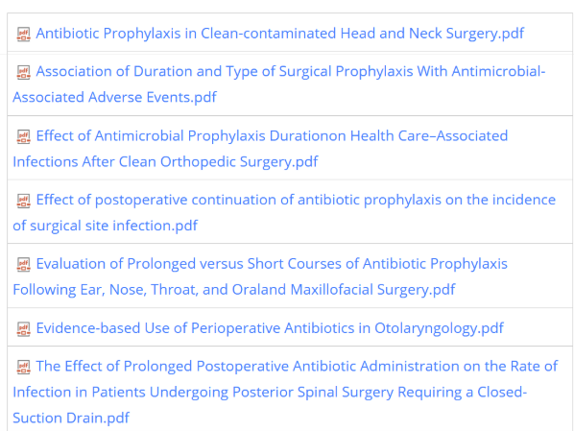
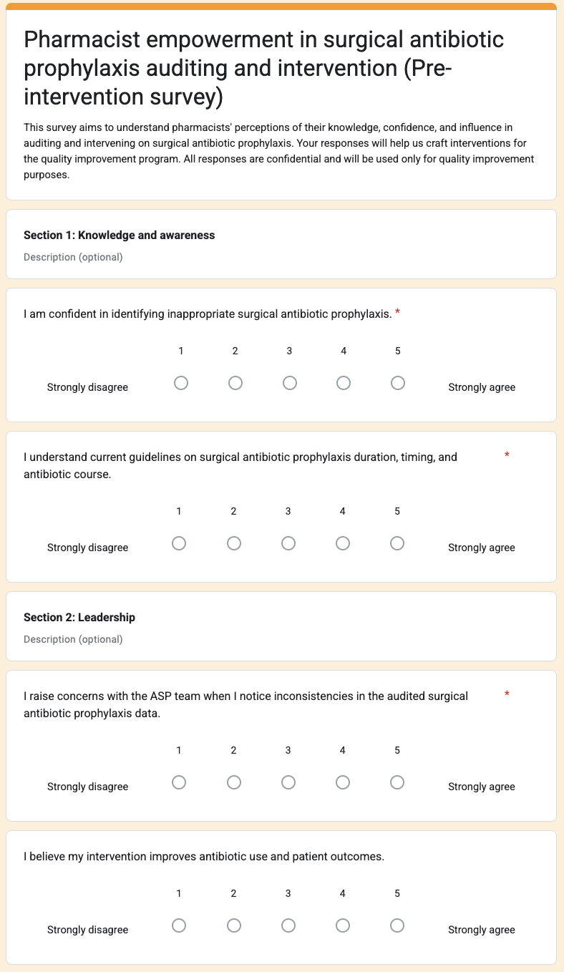
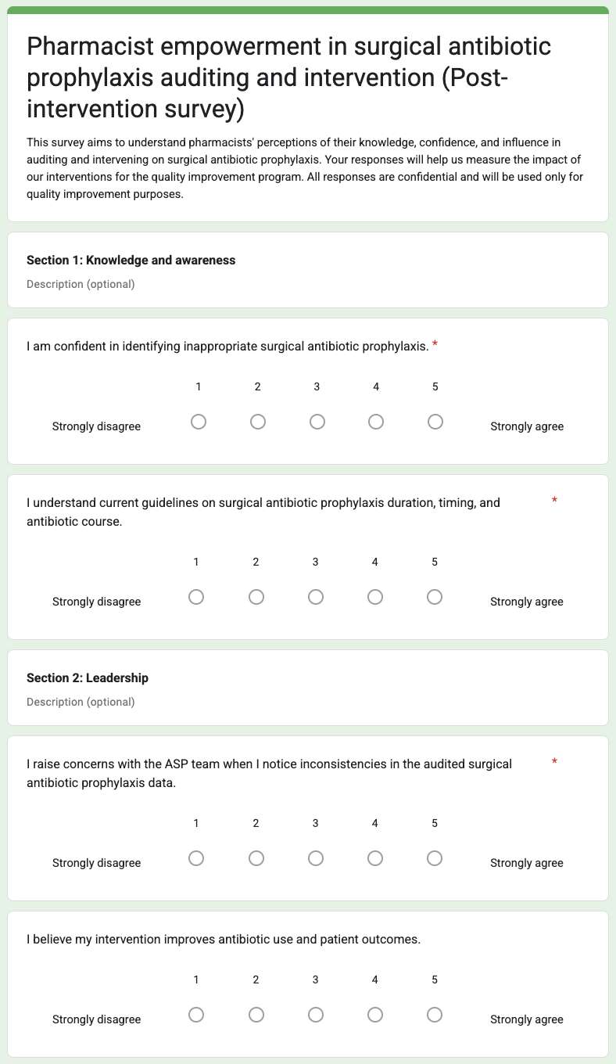
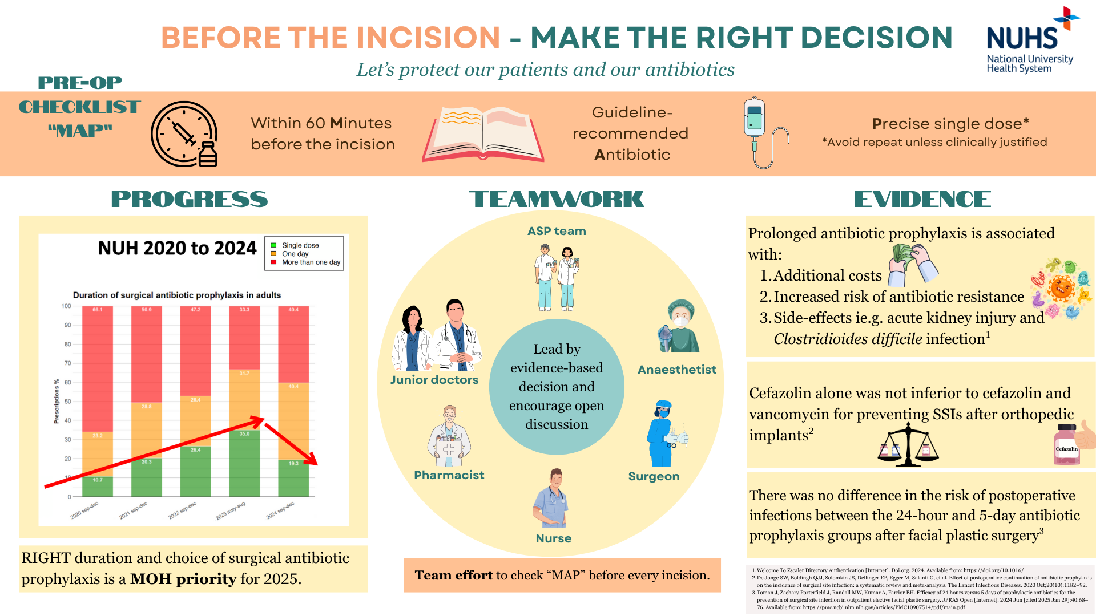
Appendix
Pareto chart
Pre- and post-intervention survey with ASP pharmacists
Literature repository with updated evidence
Informative SAP poster
Monthly feedback to departments
Choice
Duration
Sub-specialty
Revised orthopaedics and otolaryngology guidelines
Educational talk during World Antimicrobial Awareness Week 2025
Incidence of surgical site infections
References
3. Literature repository with updated evidence
1. Pareto chart
Pareto analysis showed that leadership, lack of unified guidance, knowledge and awareness gaps, and culture and communication accounted for about 80% of barriers to reduce inappropriate SAP.
Pre-intervention survey results:
Key barriers include difficulty in interpreting surgical details (e.g., implants, contamination complications) and uncertainty when cases fall outside guidelines due to limited evidence for SAP duration in complex procedures or high-risk patients. Additionally, resistance from surgeons to stewardship interventions makes it challenging to reduce or stop prolonged surgical prophylactic antibiotics.
Post-intervention survey results:
Pharmacists report feeling empowered by clearer and more defined guidelines, improved documentation, and communication from surgical teams (including infection status and rationale for prolonged duration), regular feedback, and greater engagement from surgeons.
 | Pre-QIP | Post-QIP
Knowledge & awareness | 3.25 | 4.83
Leadership | 4.00 | 5.00
Communication & culture | 2.72 | 4.67
4. Informative SAP poster
Informative poster displayed on the NUHS screensaver for 6 months.
2. Pre- and post-intervention survey
Notes:
literature repository

Slide 19
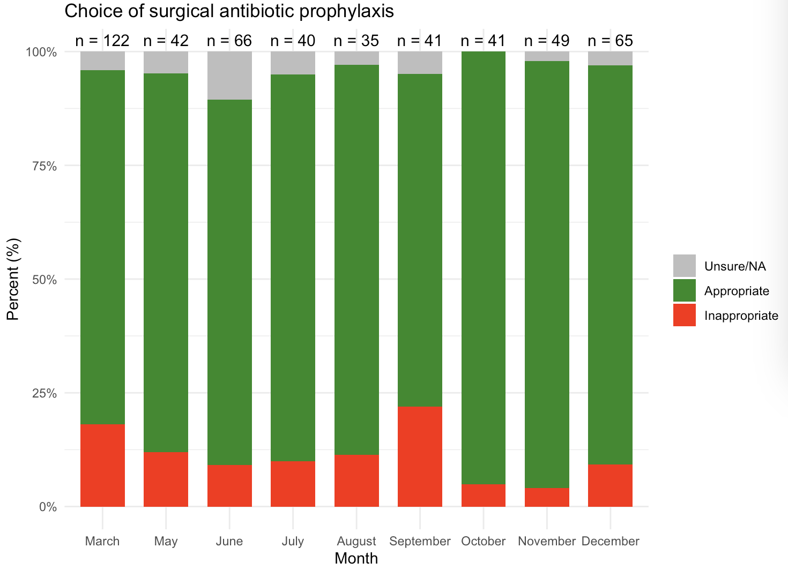
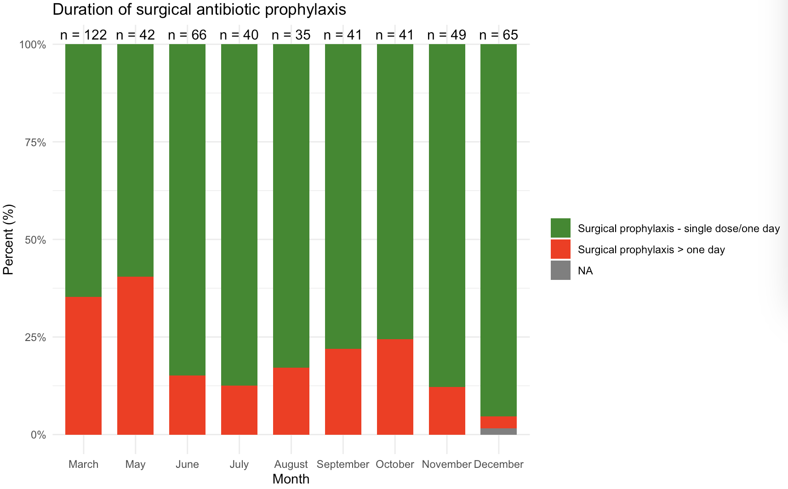
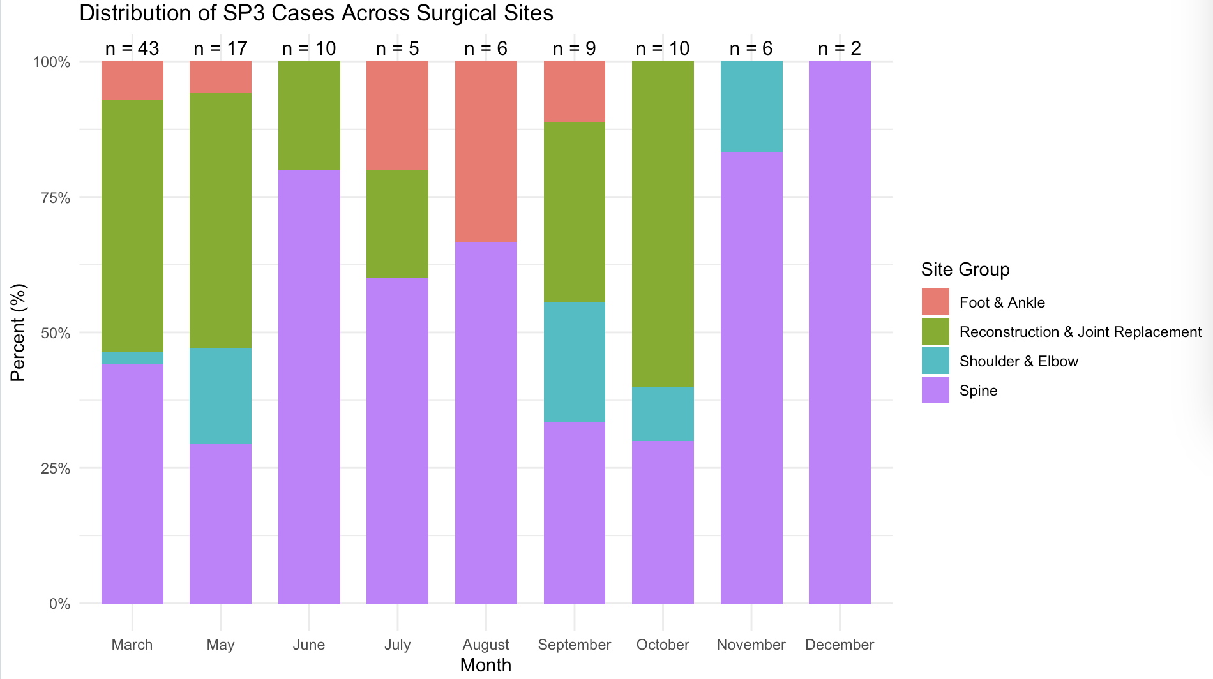
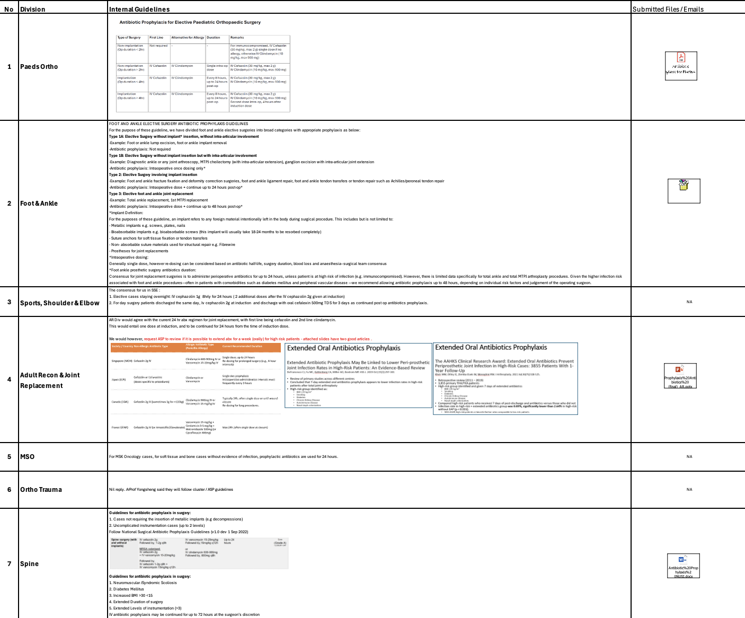
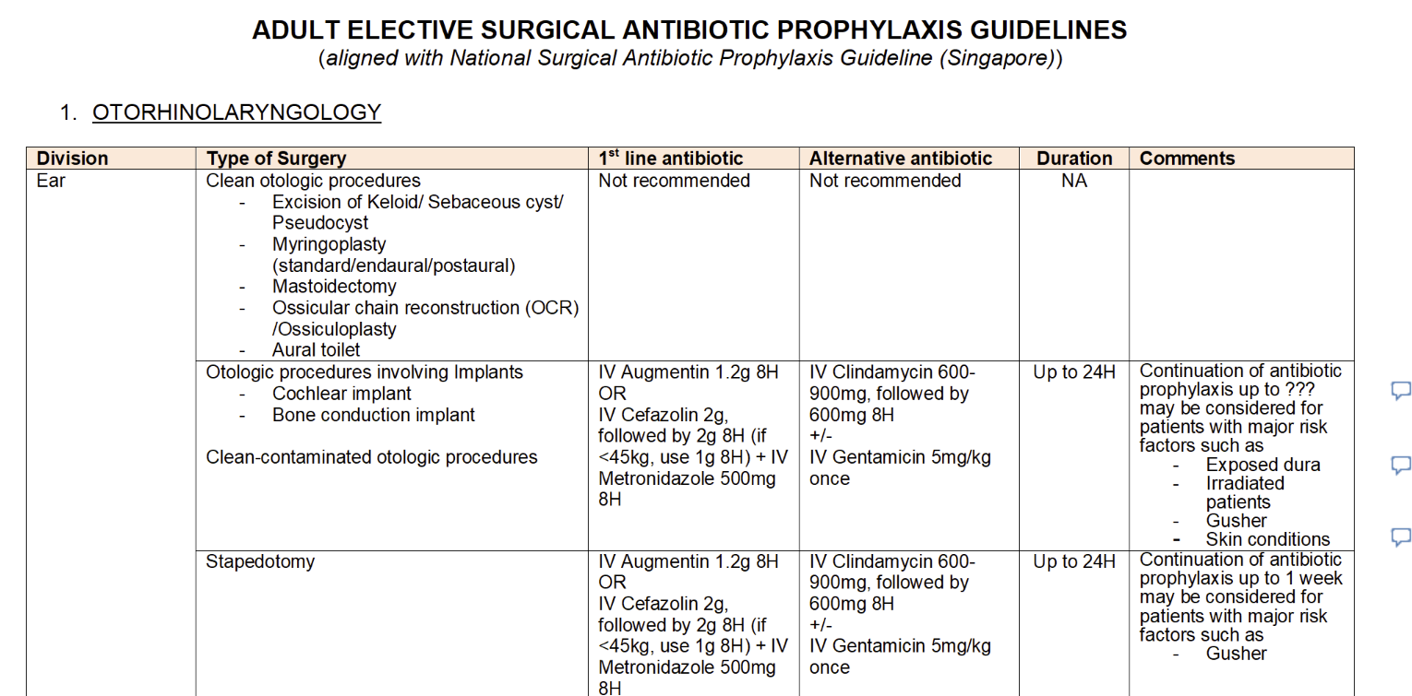
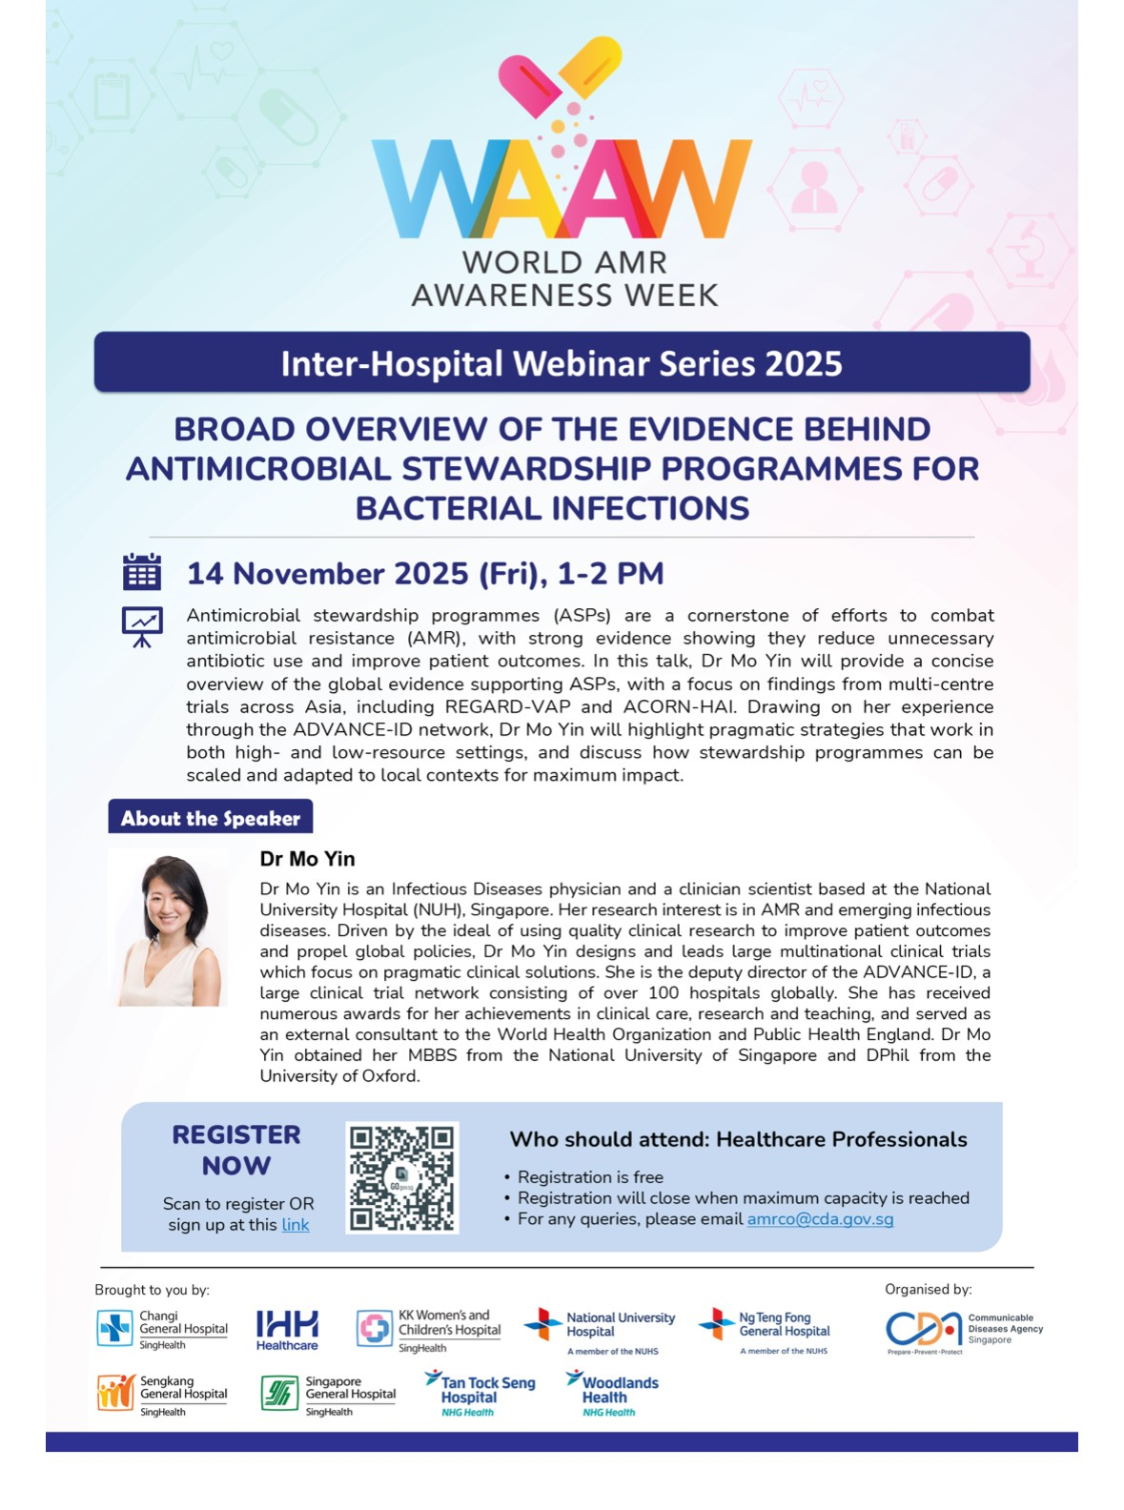
Appendix
5. Monthly feedback to departments
6. Revised orthopaedics and otolaryngology guidelines
7. Educational talk during World AMR Awareness Week

Slide 20
8. Orthopaedics surgery- surgical site infection incidence
9. References
Appendix
 | Pre-QIP |  |  |  |  |  |  | Post-QIP
 | November 2024 | December 2024 | January 2025 | February 2025 | March 2025 | April 2025 | May 2025 | June 2025 | July 2025
Total elective surgeries | 254 | 234 | 211 | 228 | 250 | 231 | 208 | 253 | 245
Total surgical site infections | 2 | 7 | 2 | 8 | 5 | 5 | 6 | 9 | 4
Surgical site infection rate (%) | 0.79 | 2.99 | 0.95 | 3.51 | 2.00 | 2.16 | 2.88 | 3.56 | 1.63
Surgical site infection rate did not increase despite reduction in antibiotic duration.
1. Chung WTG, Shafi H, Seah J, Purnima P, Patun T, Kam KQ, et al. National surgical antibiotic prophylaxis guideline in Singapore. Annals of the Academy of Medicine, Singapore [Internet]. 2022 Nov 1;51(11):695–711. Available from: https://pubmed.ncbi.nlm.nih.gov/36453217/
2. Cai Y, Venkatachalam I, Tee NW, Tan TY, Kurup A, Wong SY, et al. Prevalence of Healthcare-Associated Infections and Antimicrobial Use Among Adult Inpatients in Singapore Acute-Care Hospitals: Results From the First National Point Prevalence Survey. Clinical Infectious Diseases [Internet]. 2017 May 15;64(suppl_2):S61–7. Available from: https://academic.oup.com/cid/article/64/suppl_2/S61/3782673
3. Branch-Elliman W, O’Brien W, Strymish J, Itani K, Wyatt C, Gupta K. Association of Duration and Type of Surgical Prophylaxis With Antimicrobial-Associated Adverse Events. JAMA Surgery. 2019 Jul 1;154(7):590.

